Slide 1
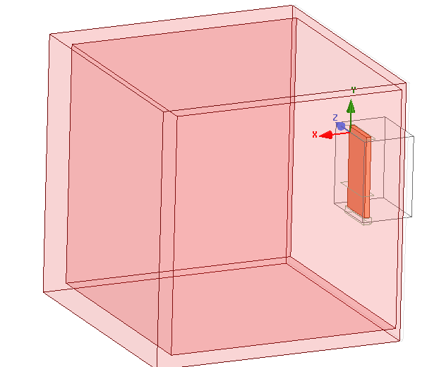
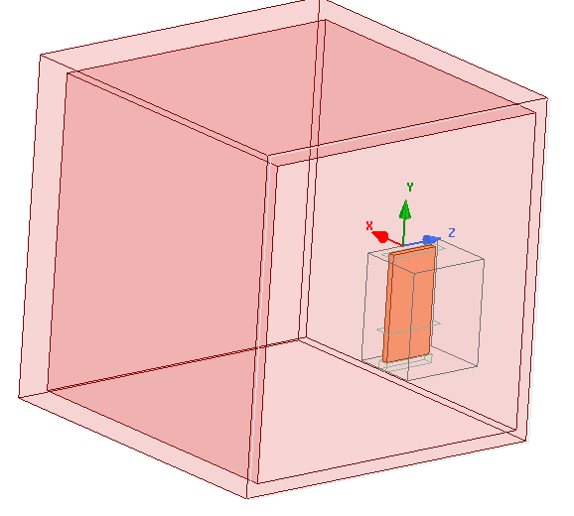
Geometry
Cube of d_vacuum length

Slide 2
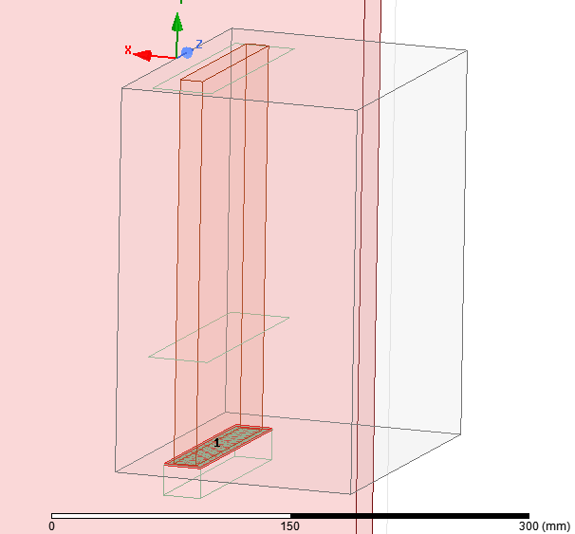
Port
short
Current evaluated @ short
Capped wave port

Slide 3
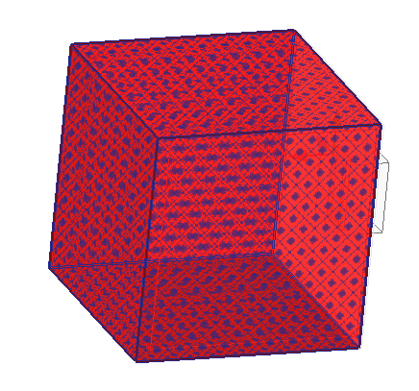
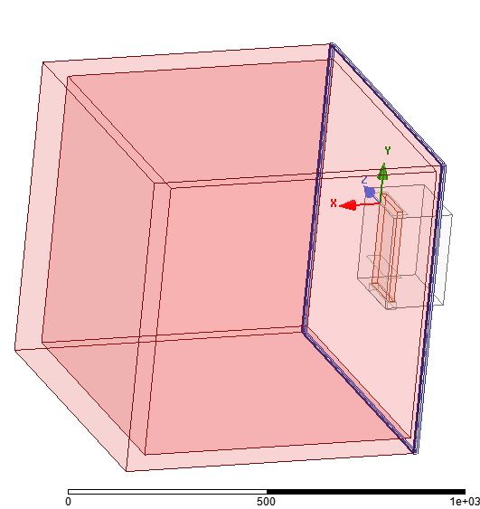
Boundary conditions
h_strap 200mm
Radiation around the dielectric
(5 faces)
Radiation around the vacuum gap (4 faces)

Slide 4
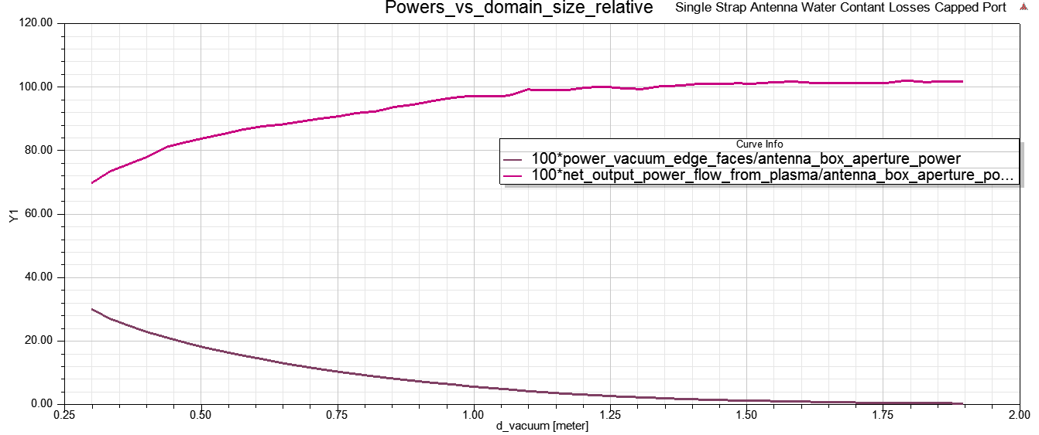
Power convergence vs dielectric domain size The dielectric domain must be large enough, otherwise the fraction of power reaching the radiating BC are different
Fraction of Power radiated from dielectric boundaries
Fraction of Power radiated from vacuum boundaries

Slide 5

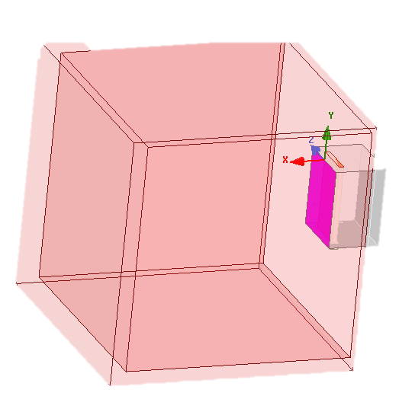
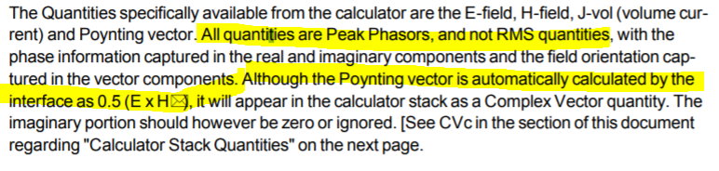
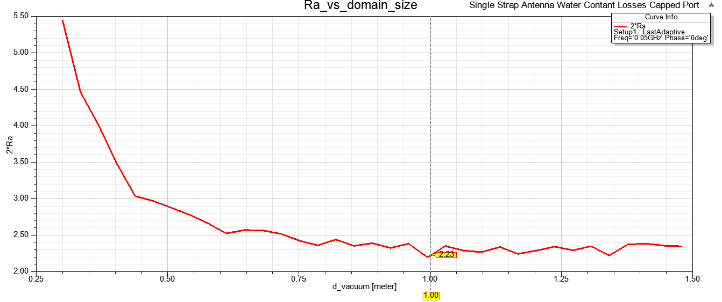
Aperture resistance
Power rad from aperture : int(Re[Poynting].dS)
Defined as :
But I_{HFSS} = I_{peak} = sqrt(2) I_{rms} but P_{rad} is time-averaged → R_{a} x sqrt(2)^2 to match ANTITER ?
Ra ~ 1,1 → 2xRa = 2,23

Slide 6
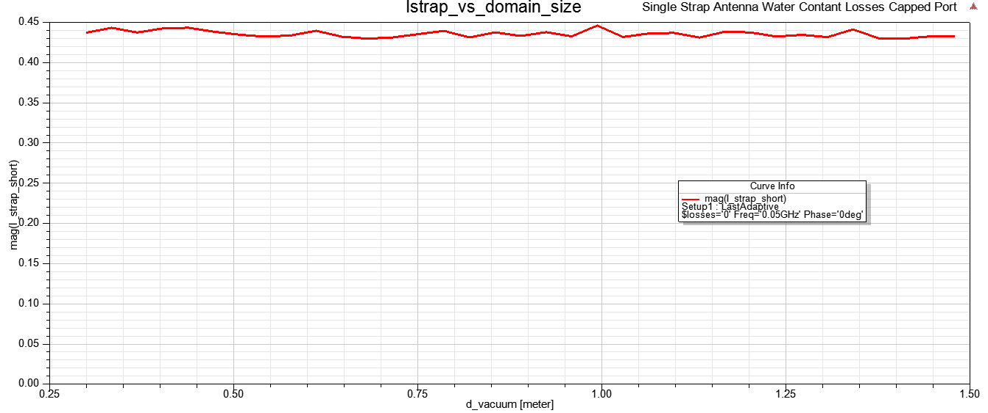
Current
Current ~ constant independently of dielectric size

Slide 8
Old results, probably most wrong and to be revised

Slide 9
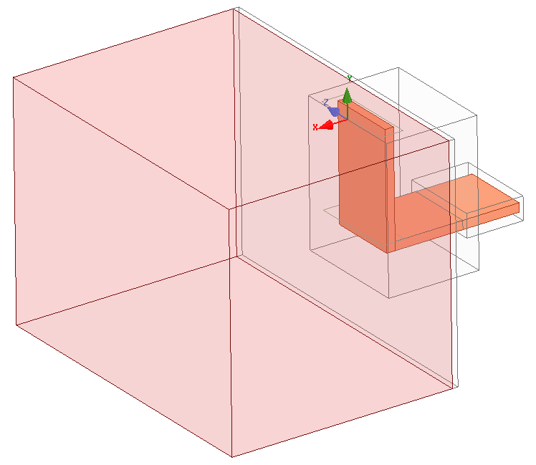
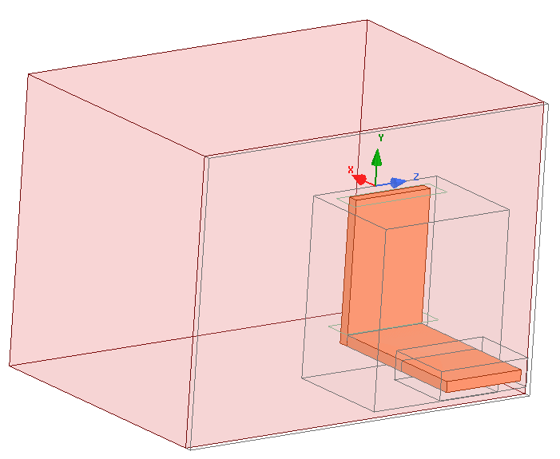
1 strap – lossy water eps_{r}=(81-1j*$losses)
Radiation BCs

Slide 10
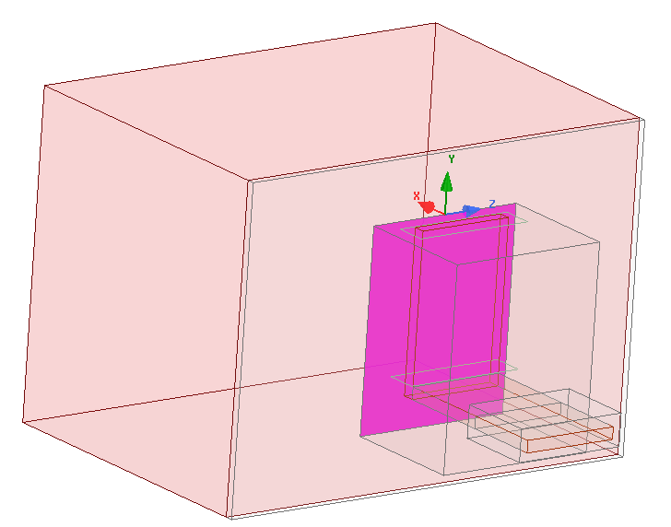
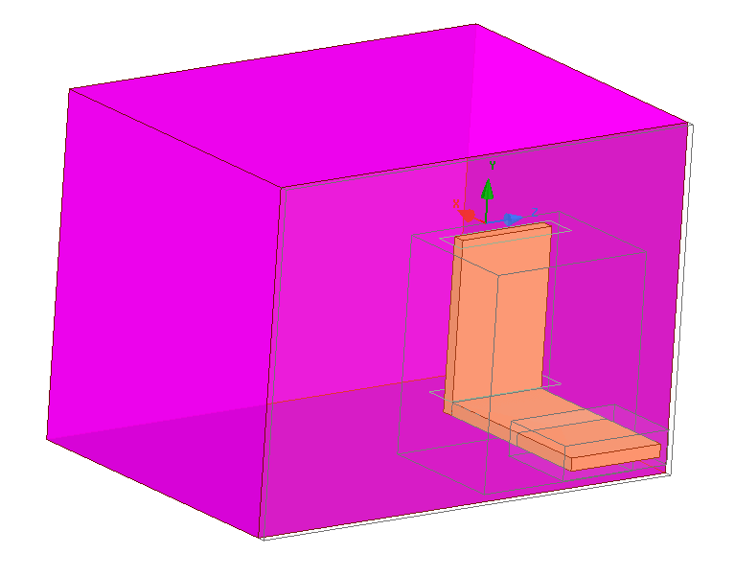
Parameters
P_transferred : int(Re(Poynting))
P_radiated : int(Re(Poynting))
Convergence criterium on Z: 1% real and im parts

Slide 11
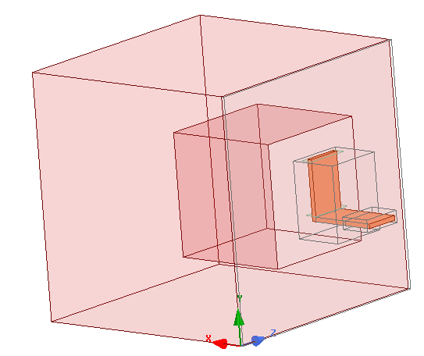
Step 1 : size of the plasma box
Increasing the propagation medium box size to see the size at which the port impedance converge
losses = 0 → Plasma1=plasma2
Radiation BC
Plasma 2
Plasma 1
d
losses = 0 → Plasma1=plasma2
Radiation BC
D
2D

Slide 12
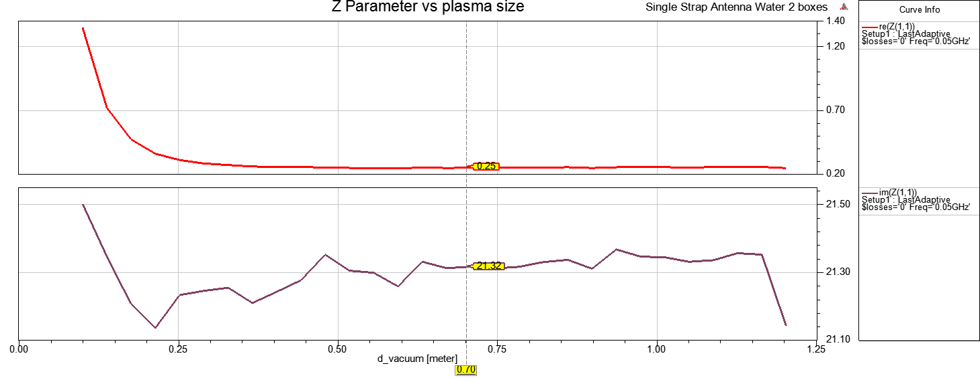
Convergence reached for D~>0.5m
« 1st Rule of thumb » : radiation medium size > 4 antenna box largest size (250mm here)
(lambda ~ 6m → ~ radiation medium size > lambda/6 at min?)
→ Target result for next simulations: Z=0.25+21.3j
Antenna box : d=0.16 m, h=0.25m
D [m]

Slide 13
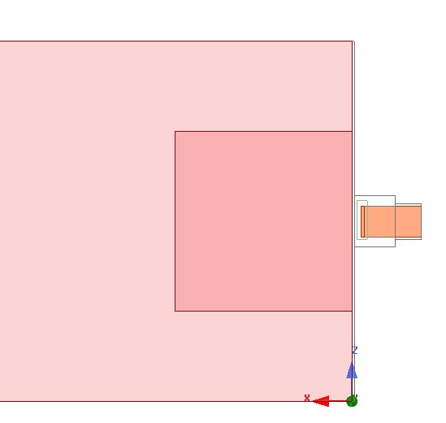
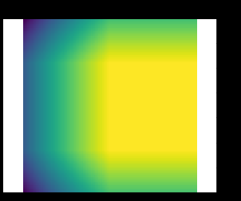
Step2 : creating a lossy plasma surrounding a low or non-lossy plasma
PerfectE BC
D
d
Plasma1,
Constant losses
ε"(x,z)
ε" = -0.1
Pin
Plasma2,
Increasing losses
Pout
Dummy boundary, close to PerfE BC

Slide 14
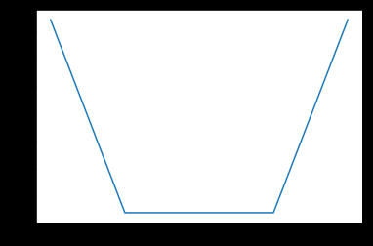
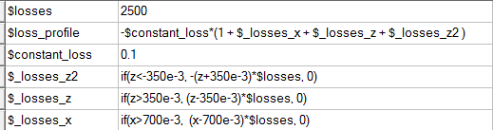
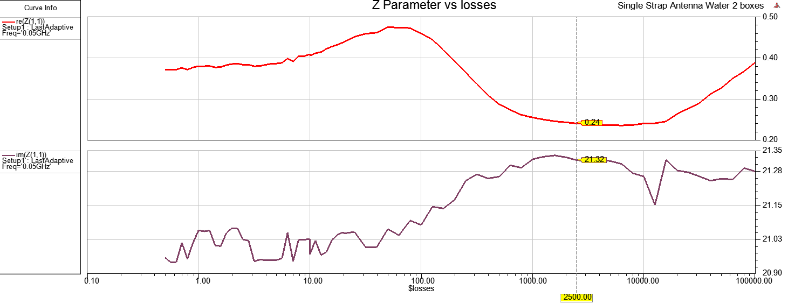
Linear loss evolution
2500

Slide 15
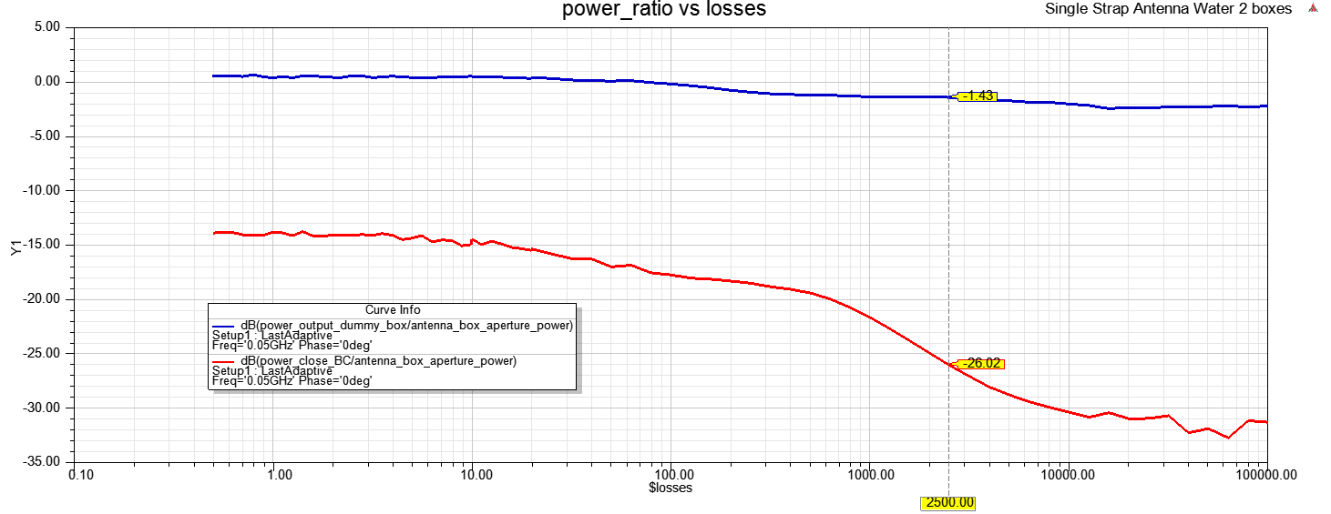
-30dB between antenna aperture and ~BC

Slide 16
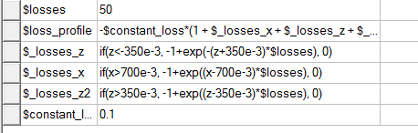
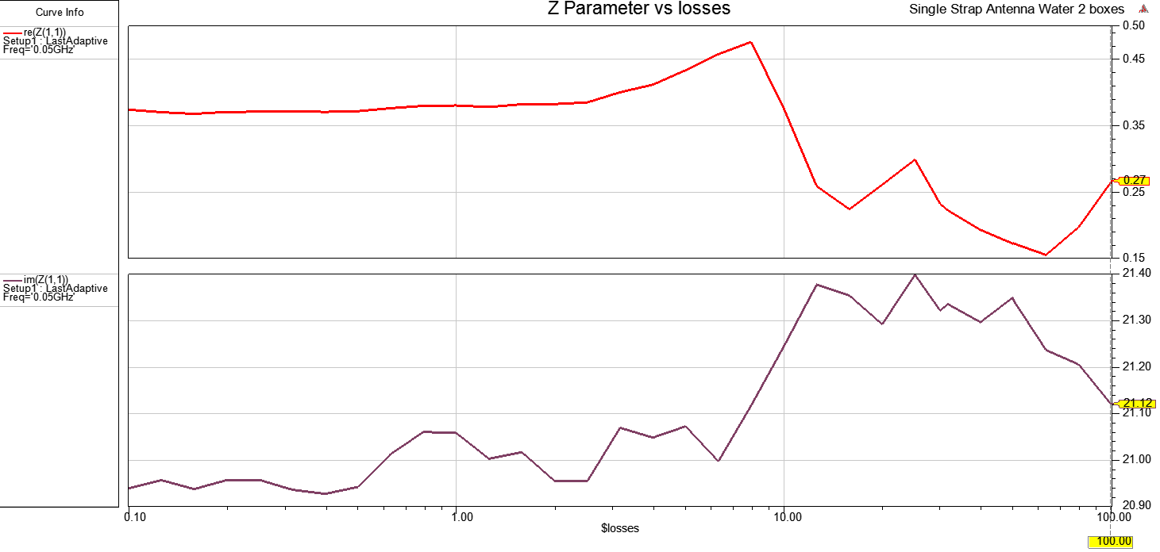
Exponential loss evolution

Slide 17
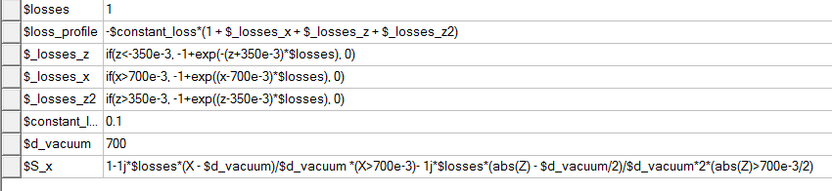
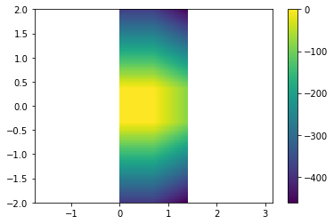
PML-like evolution
Epsr_HFSS = epsr . S(x)

Slide 18
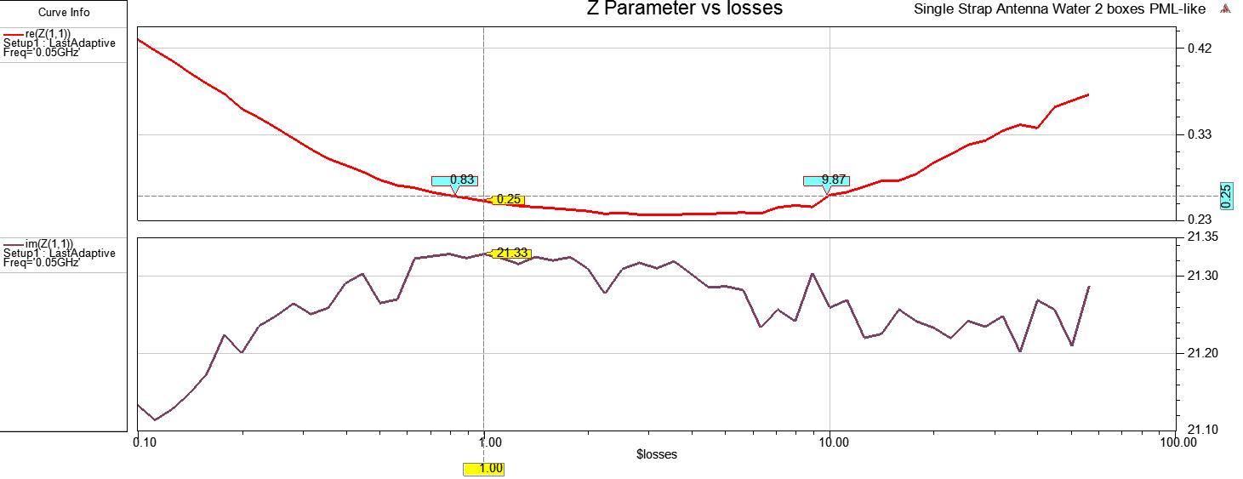
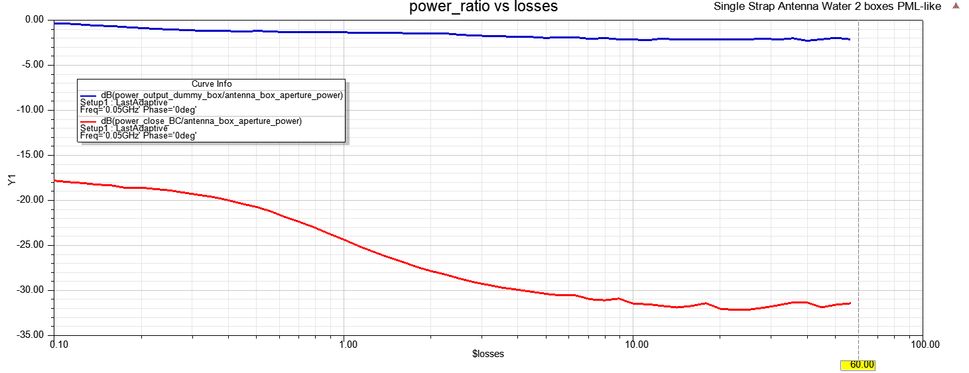
-25 dB

